Slide 1
405 BBLAB Machine Learning
2023/12/27

Slide 2

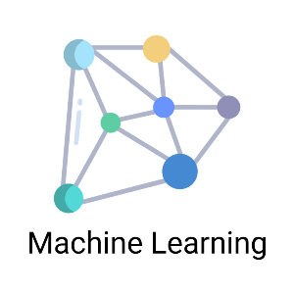
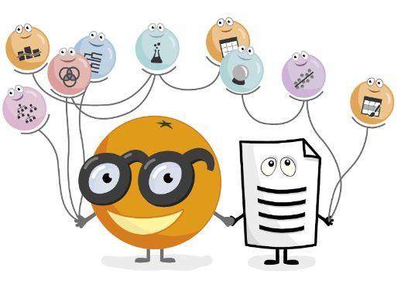
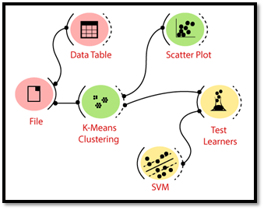
Outline
Intro
Concepts
Demo
Orange

Slide 3

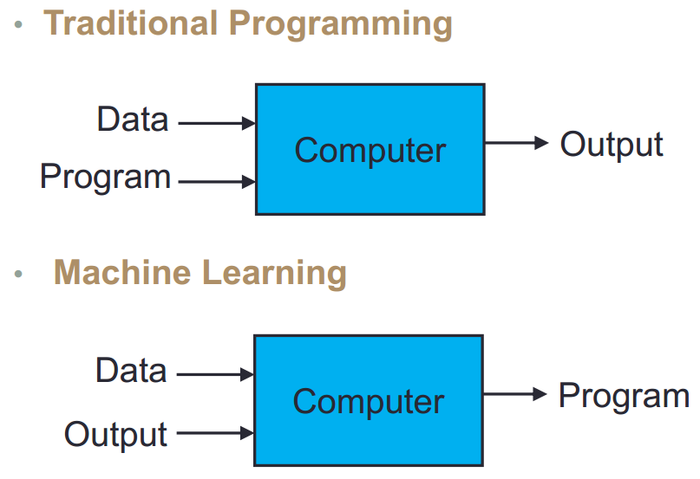
What is Machine Learning?
Getting computers to program themselves – let the computer learns from the data instead!
Difference

Slide 4
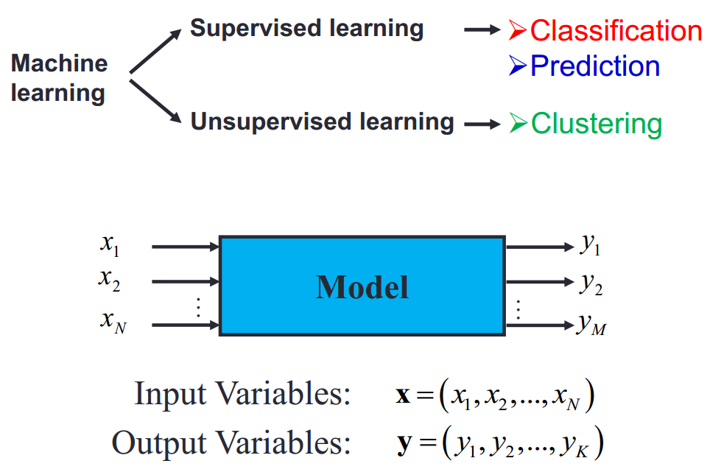
Types of Machine Learning

Slide 5
Some Application Examples
Science (Medical imaging, bio-informatics)
Retail (Stock control, demographic store placement)
Manufacturing (Quality control, automated monitoring)
Health care (Scheduling)
Security (Intelligent smoke alarms, fraud detection)
Marketing (Targeting promotions)
Finance (Credit scoring, risk analysis...)

Slide 6
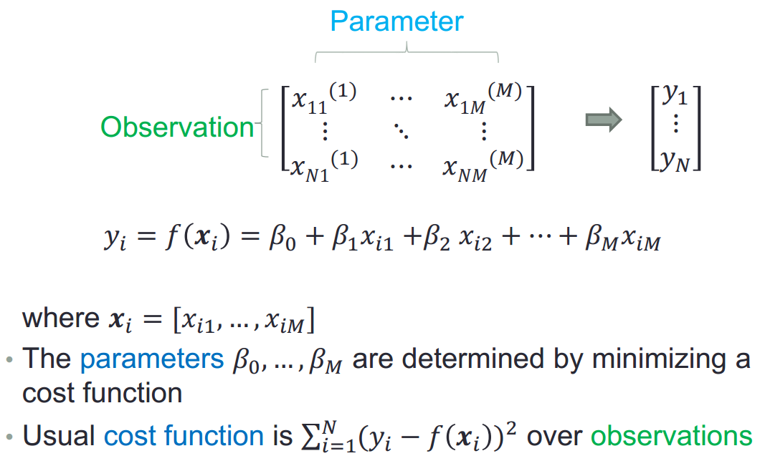
Ex1: Linear Regression

Slide 7
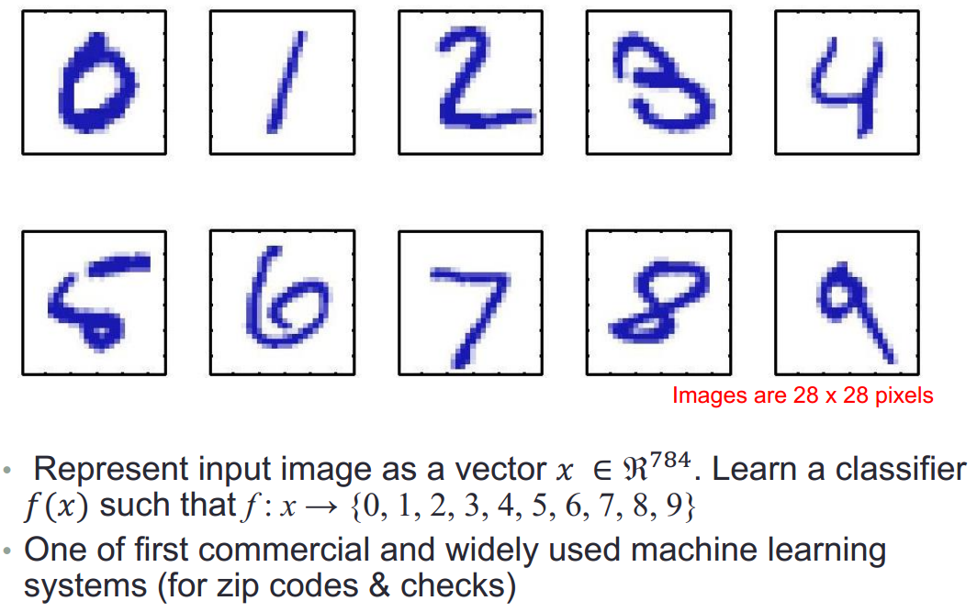
Ex2: Handwritten Number Recognition

Slide 8
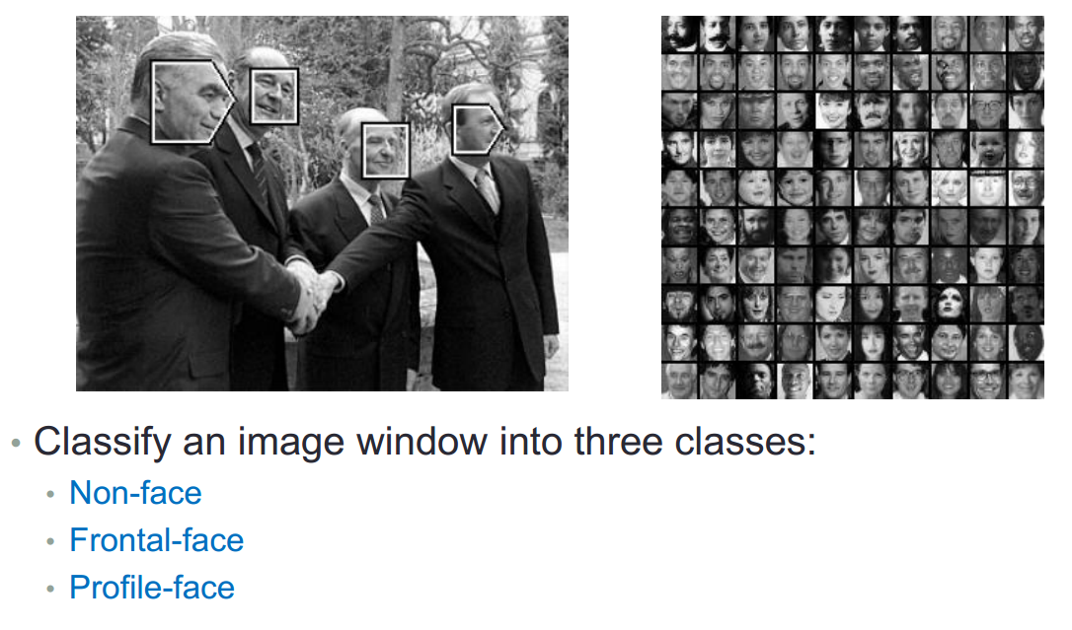
Ex3: Face Detection

Slide 9
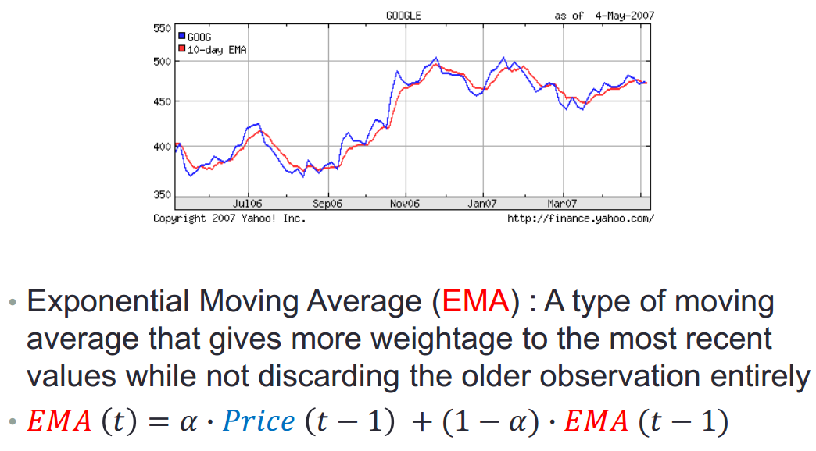
Ex4: Stock Price Prediction

Slide 10
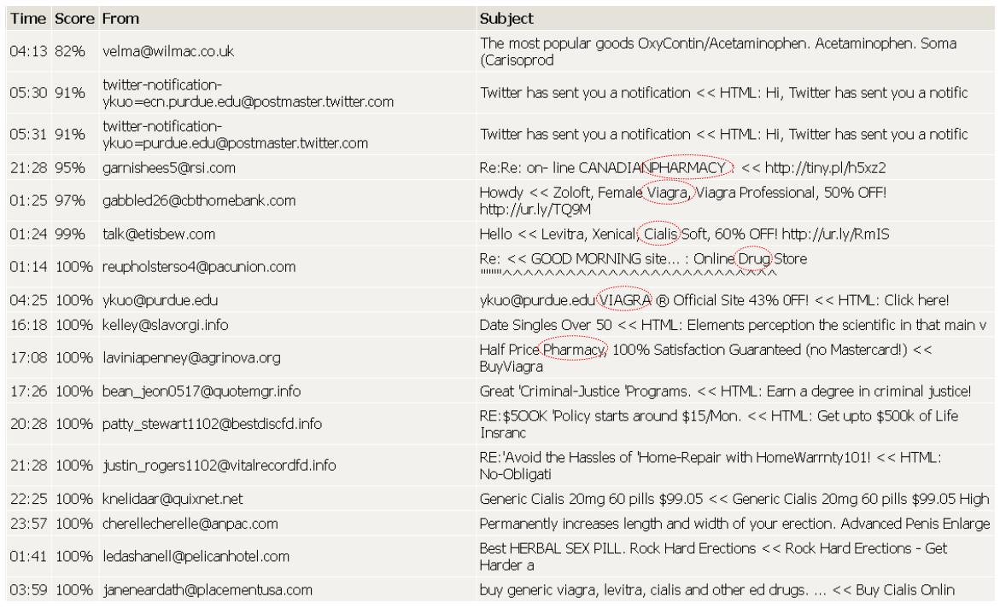
Ex5: Spam Classification

Slide 11
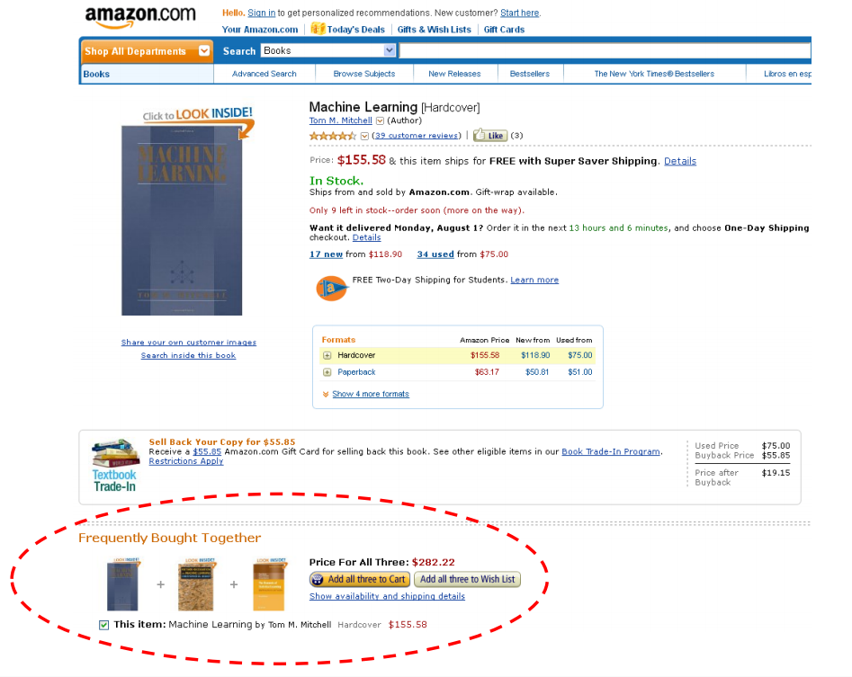
Ex6: Recommender System

Slide 12
Machine Learning Types
監督式學習 Supervised Learning
非監督式學習 Unsupervised Learning
半監督式學習 Semi-Supervised Learning
強化學習 Reinforcement Learning

Slide 13
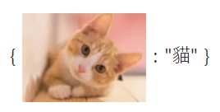
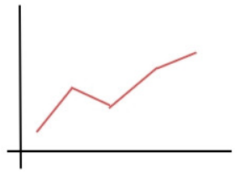
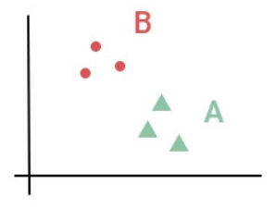
Supervised Learning
資料跟答案成對的數據 -> 標籤資料（labeled data）
輸入（資料）+ 輸出（答案）= 函數
解決回歸和分類問題

Slide 14
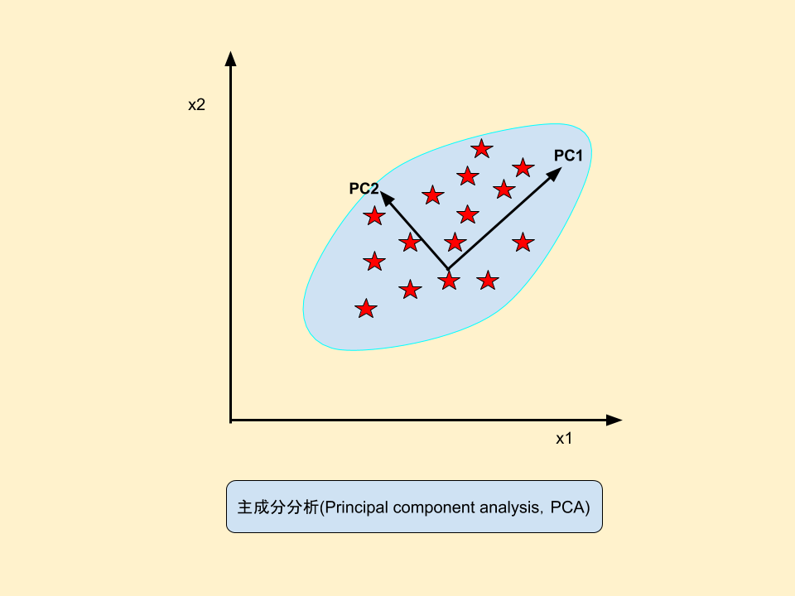
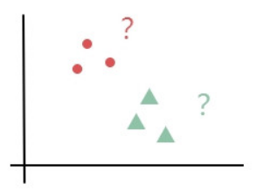
Unsupervised Learning
Supervised 跟 Unsupervised分類差異
有無標籤資料
有答案的分類 沒有答案的分類
資料沒有答案的學習 -> 無標籤資料
輸入（資料）+ 輸出（X）= 函數
解決降維和分類問題

Slide 15
Semi-Supervised Learning
有些資料有標籤，有些沒標籤
監督式學習用答案校正所以準確率很高，但多數資料一開始沒有答案，如果把所有資料上標籤，人力成本太高
無監督式雖然人力成本低，但自行做的聚類不一定正確
這時候使用一部分有標籤的資料先找出好的特徵比起全部使用無監督式會更精準

Slide 16
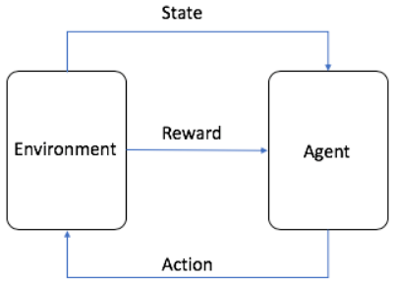
Reinforcement Learning
使用懲罰和獎勵邊做邊修正
模仿人類的反覆試驗學習過程
Ex: AlphaGo、自動車

Slide 17
Concept
Problems
ML Types
Optimization
ML Algorithms

Slide 18
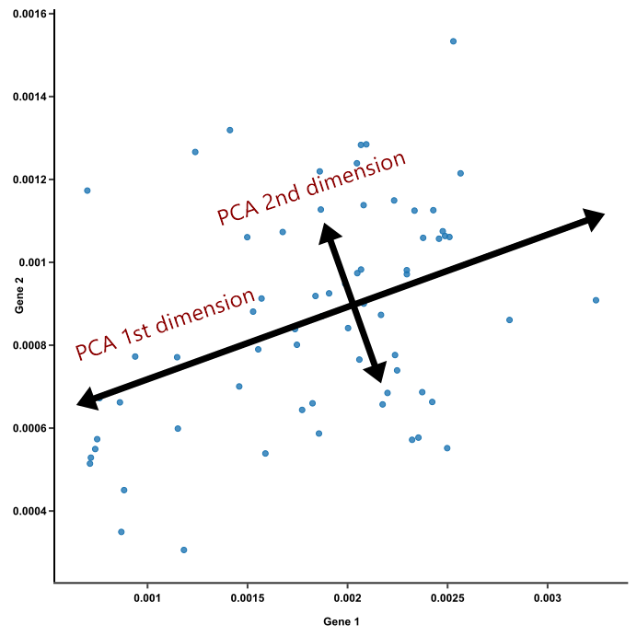
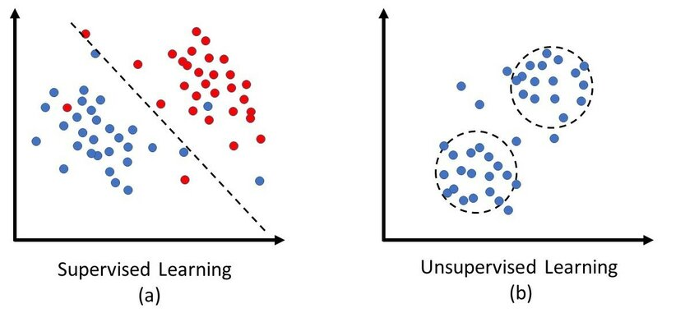
Machine Learning Algorithms
PCA | CLASSIFICATION | CLUSTERING

Slide 19
Principal Components Analysis
Unsupervised Learning
化繁為簡
將原本高維度的數據重新以一個低維度的形式表達
只要低維度的特徵就能夠代表大部分高維度的特徵

Slide 20
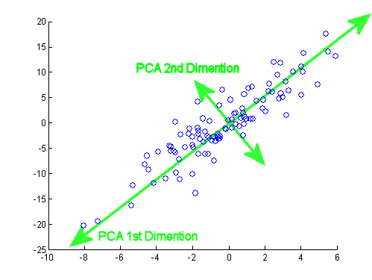
Concepts
將坐標軸中心移到數據的中心，然後旋轉坐標軸，使得數據在PC1軸上的變異數最大，代表著更多的訊息被保留下來PC1成為第一主成分。
PC2第二主成分：找一個PC2，使得PC2與PC1的共變異數（相關係數）為0，避免與PC1特徵重疊，並且使數據在PC2軸上的變異數最大。

Slide 21

Visualization

Slide 22
Classification vs Clustering
Parameter | CLASSIFICATION | CLUSTERING
Type | Supervised learning | Unsupervised learning
Basic | Process of classifying the input based on their corresponding class labels | Grouping the input based on their similarity without the help of class labels
Need | It has labels so there is need of training and testing dataset for verifying model | There is no need of training and testing dataset
Complexity | More complex | Less complex
Example Algorithms | Perceptron Logistic regression | K-means clustering

Slide 23
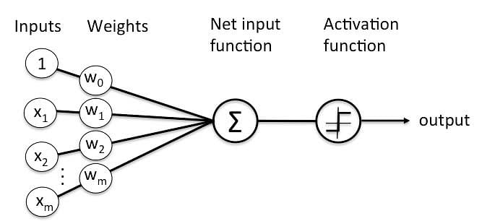
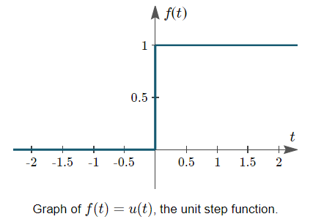
Perceptron
Supervised Learning
輸出分類結果
Step function
能得到分類結果，但無法得知個別機率
Next slide -> Logistic Regression

Slide 24
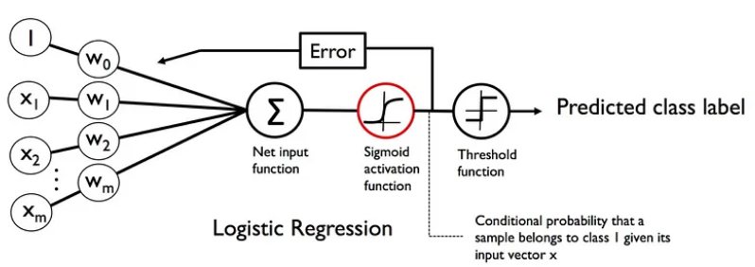
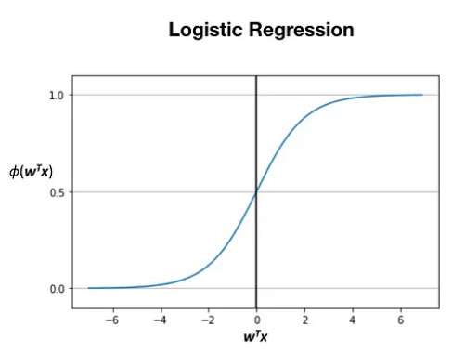
Logistic Regression
Supervised Learning
輸出機率值(0到1之間)
Sigmoid function
根據溫度、濕度、風向預測天氣
得到晴天以及雨天的機率

Slide 25
K-means Clustering
Unsupervised Learning
用資料本身去分類
Ex: 給定一組身高和體重的資料，但不知道哪些是男生哪些是女生。希望用這組資料自動分出男生女生

Slide 26
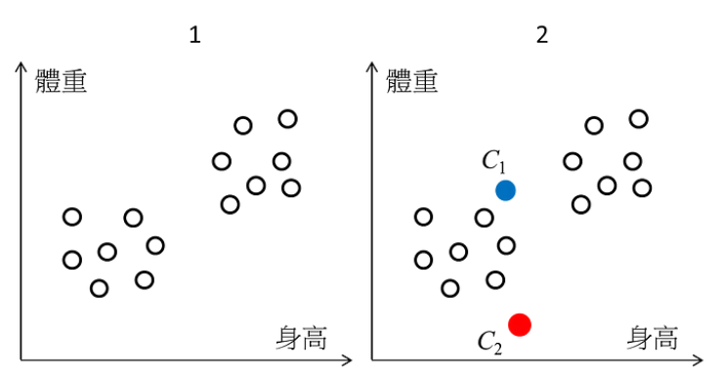
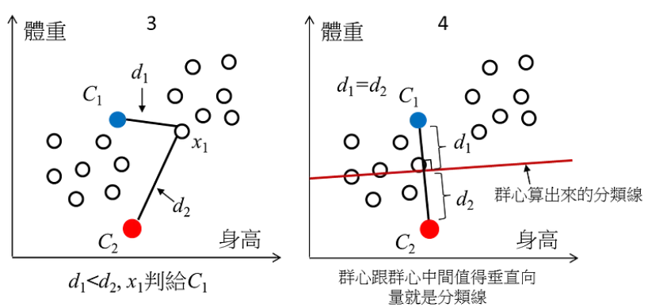
K-means Clustering
給定一組身高和體重的資料，但不知道哪些是男生哪些是女生。希望用這組資料自動分出男生女生

Slide 27
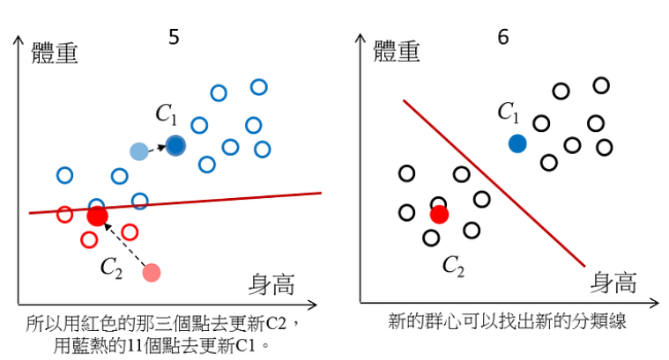
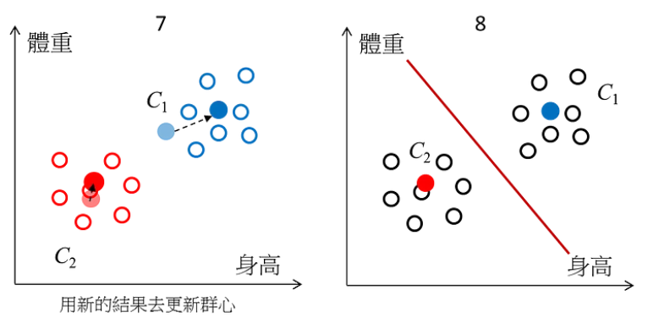
K-means Clustering
給定一組身高和體重的資料，但不知道哪些是男生哪些是女生。希望用這組資料自動分出男生女生

Slide 28
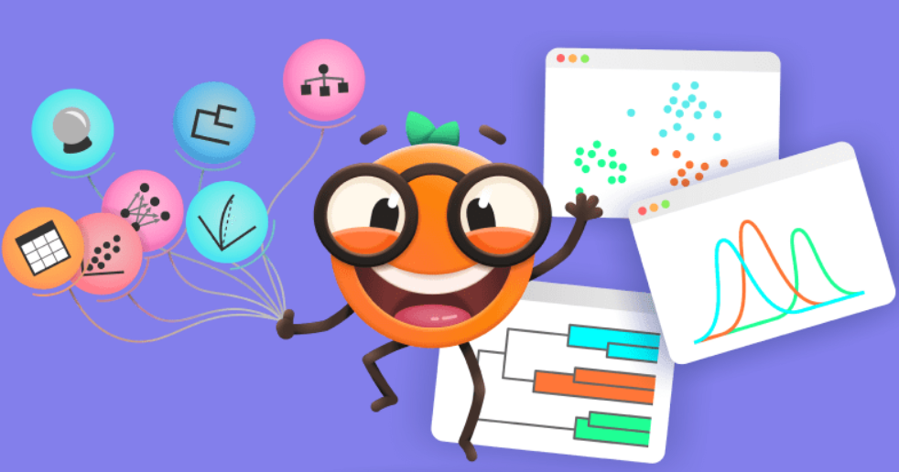
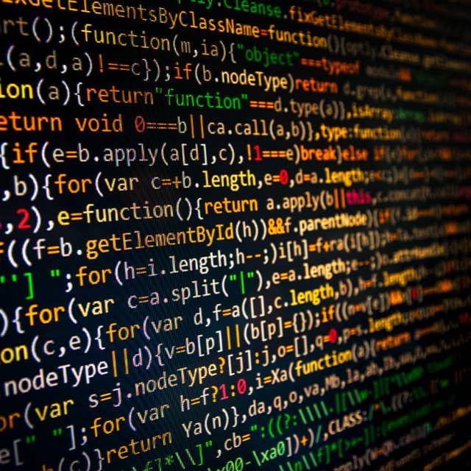
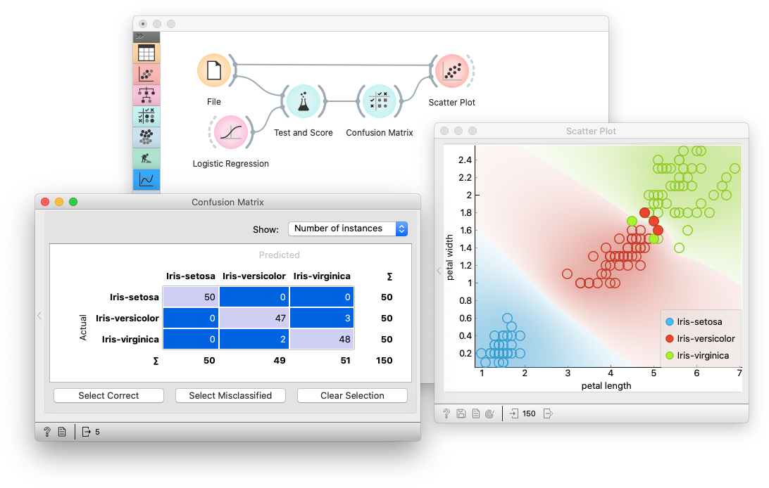

Orange
Open source machine learning and data visualization
Preliminary analysis before coding

Slide 29
Advantages
Quickly testing which machine learning method is most useful
Reduce programming time
Visualization charts are suitable in the report
College Student Research Scholarship

Slide 30
Tutorial
https://orangedatamining.com/examples/
https://youtube.com/playlist?list=PLmNPvQr9Tf-ZSDLwOzxpvY-HrE0yv-8Fy&si=9iDgnHsqaronHWSa

Slide 31
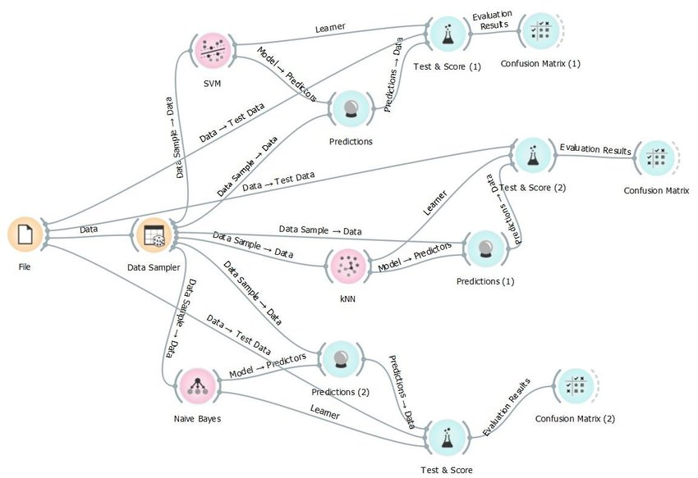
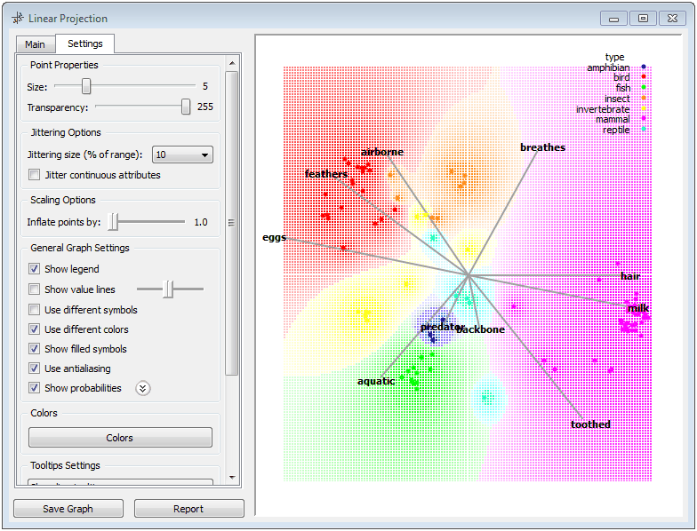
Demo

Slide 32
Demo
Model evaluation and Scoring (Logistic Regression/RF)
Add-ons
Principal Component Analysis
K-Means

Slide 33
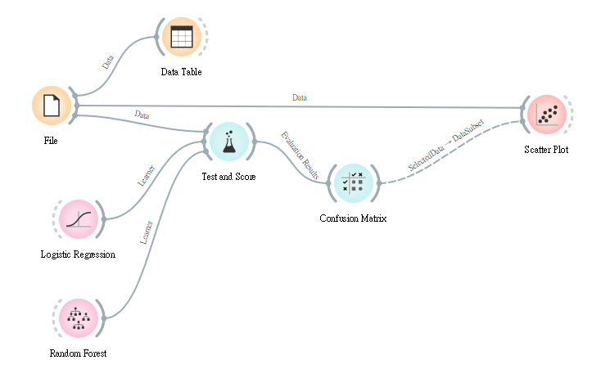
Model evaluation and Scoring
2
5
1
7
6
3
4
8

Slide 34
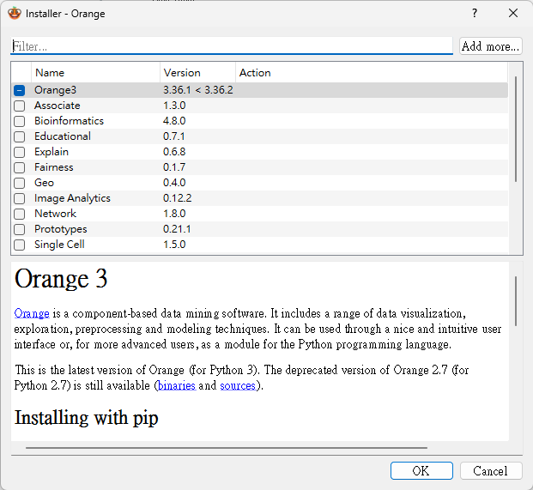
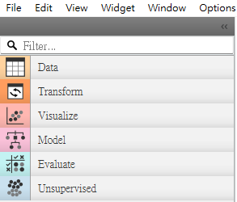
Add-ons

Slide 35
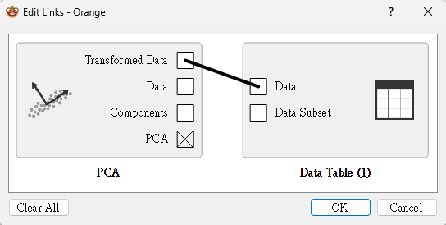
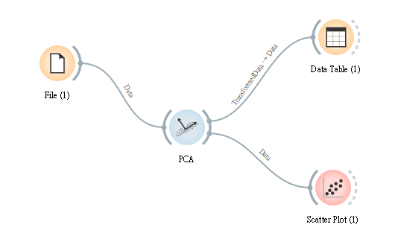
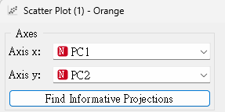
Principal Component Analysis
3
1
4
2
5

Slide 36
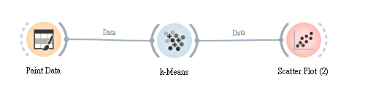
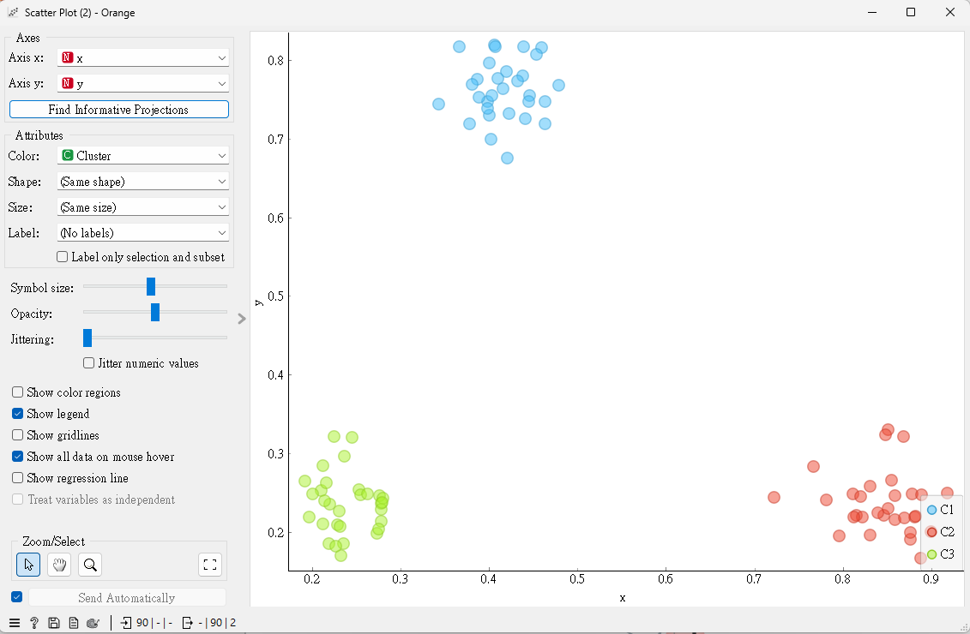
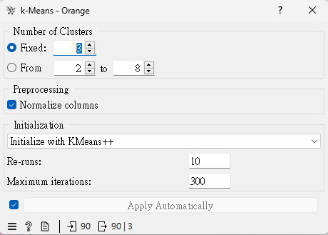
K-Means

Slide 37
References
https://orangedatamining.com/
https://youtube.com/playlist?list=PLmNPvQr9Tf-ZSDLwOzxpvY-HrE0yv-8Fy&si=9iDgnHsqaronHWSa
https://www.notion.so/wesleych3n/Machine-Learning-2-Orange-5870b44fbc964688bba0c0dbbd32be2f
https://www.notion.so/wesleych3n/Machine-Learning-3-Orange2-f89733b5c1024e9bbed476edc781ccec

Slide 38

Thanks for listening

